Slide 1


AWS Code Commit
Wolfgang Unger
AWS Solutions architect | INSTRUCTOR
AWS fully managed source control system

Slide 2

Code Commit
Wolfgang Unger
AWS Solutions Architect | instructor

Slide 3


Chapter overview
Introduction
Code Commit
GIT
Chapter Overview
Summary
Wolfgang Unger
AWS |Solutions Architect | Instructor

Slide 4
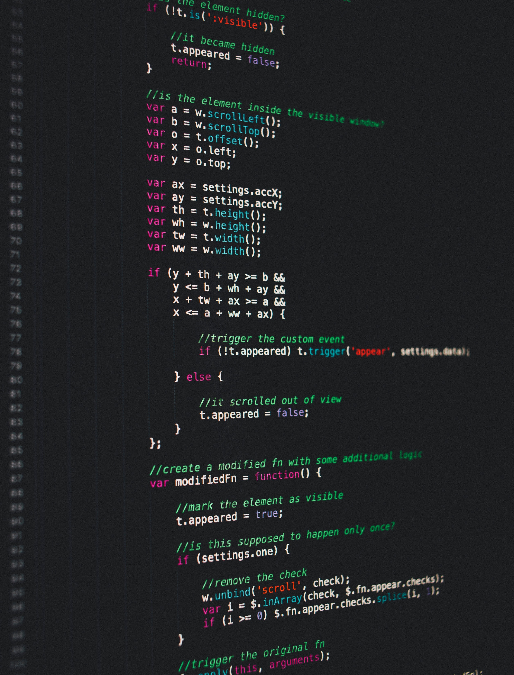
AWS definition :
“AWS CodeCommit is a fully-managed source control service that hosts secure Git-based repositories. It makes it easy for teams to collaborate on code in a secure and highly scalable ecosystem. CodeCommit eliminates the need to operate your own source control system or worry about scaling its infrastructure.”
Notes:
Karel Capek, a Czech novelist introduced and made popular the word robot as a word for artificial human beings. It first appeared in his play R.U.R. (Rossum’s Universal Robots) in 1920. In Czech, the word means worker or servant.

Slide 5
AWS CodeCommit is a version control service hosted by Amazon Web Services that you can use to privately store and
manage files, such as documents, source code, and binary files in the cloud.
It supports the standard functionality of Git, so it works seamlessly with your existing Git-based tools.
Or with other words:
With CodeCommit you can host private Git repositories on AWS.
Notes:
The official definition of a robot, by Robot Institute of America.

Slide 6

Benefits
1
GIT based
It supports the standard functionality of Git, so it works seamlessly with your existing Git-based tools.
2
AWS Integration
Good Integration with other AWS services, like CodeBuild, CodePipeline, CloudWatch and more
3
Easy migration to Code Commit
Easily migrate files from other remote repositories.
You can migrate to CodeCommit from any Git-based repository.

Slide 7


TITLE TEXT
GIT
Cloud Guru GIT course 1
Cloud Guru GIT course 2
This course is perfect to learn GIT from the basics to advanced features …
Lorem of for ipsum randomised words our, don't look even night offer slightly beration be ration Lorem of for ipsum
Additional GIT training sources
Pro Git, an online version of the Pro Git book. Written by Scott Chacon. Published by Apress.
Git Immersion, a try-it-yourself guided tour that walks you through the fundamentals of using Git.
Published by Neo Innovation, Inc.
Git Reference, an online quick reference that can also be used as a more in-depth Git tutorial.
Published by the GitHub team.
Git Cheat Sheet with basic Git command syntax. Published by the GitHub team.
Git Pocket Guide. Written by Richard E. Silverman. Published by O'Reilly Media, Inc.

Slide 8
Chapter overview
Introduction and chapter overview
Create first CodeCommit Repo
Browse files in Repo
Integration with Eclipse and VisualStudio
Triggers and webhooks
Branches
Pull requests
Summary
Notes:
Karel Capek, a Czech novelist introduced and made popular the word robot as a word for artificial human beings. It first appeared in his play R.U.R. (Rossum’s Universal Robots) in 1920. In Czech, the word means worker or servant.

